Slide 1


Slide 2
Open Drone Map
Not a drone &&
Not a map &&
Open like the copyleft...

Slide 3
Obligatory Diagram
Point Cloud
Digital
Surface
Model
Images
Textured
DSM
Ortho
Imagery

Slide 4
So, what is?
Is:
  Processing toolchain for civilian UAS imagery
  Based on Bundler, PMVS, CMVS (computer vision stuff)
  Deployable on Ubuntu 12.04 32-bit
  Incomplete

Slide 5
So, what is not?
Snot:
  Complete
  Full 3D point cloud and mesh editing environment (see Meshlab, CloudCompare, others)
  Flight planning software (see Ardupilot)
  A panacaea

Slide 6
So, what is not yet?
Snot yet:
  Complete
  Mesh creator
  Textured mesh creator
  Orthophoto maker

Slide 7
Obligatory Diagram (1)
terminal
Files

Slide 8
Obligatory Diagram (2)
WWW
QGIS
terminal
Files
PostGIS

Slide 9
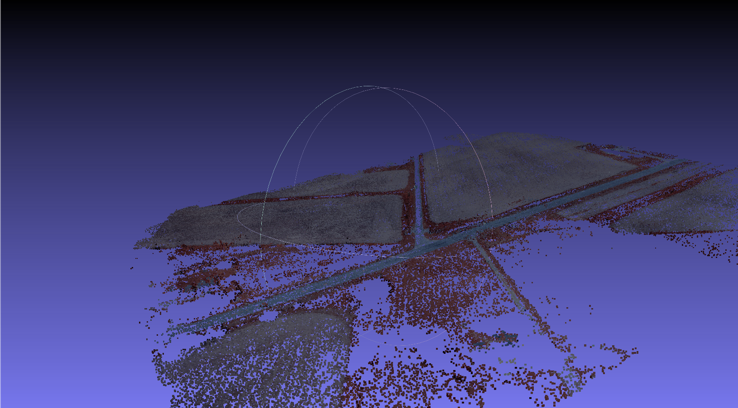
Pretty Picture Time...

Slide 10
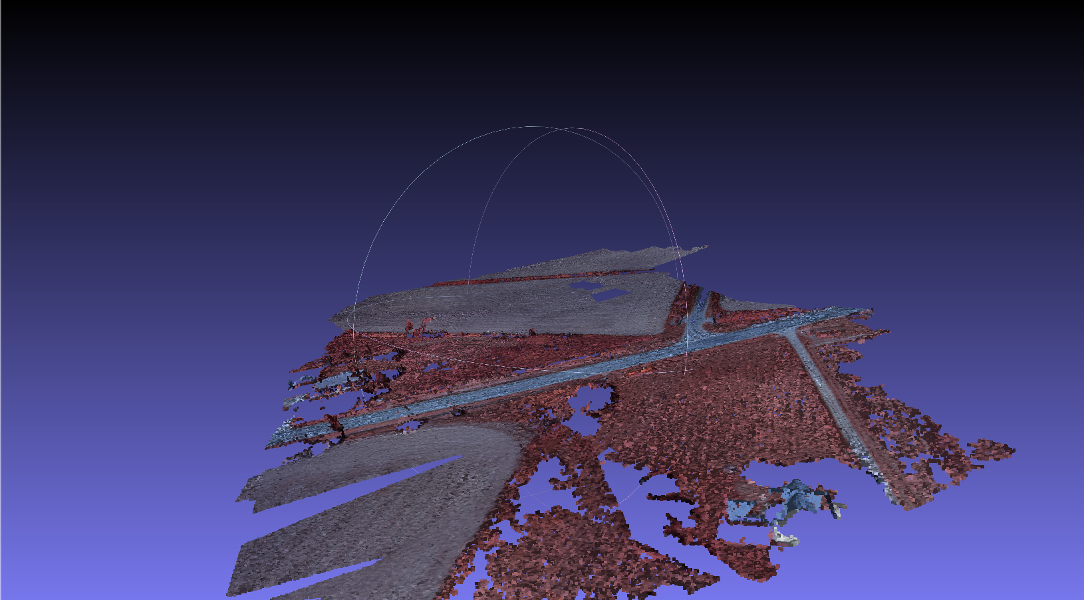
Pretty Picture Time...

Slide 11
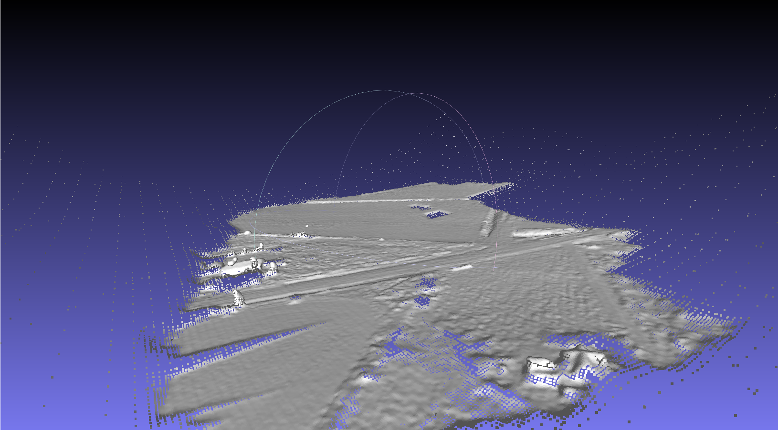
Pretty Picture Time...

Slide 12
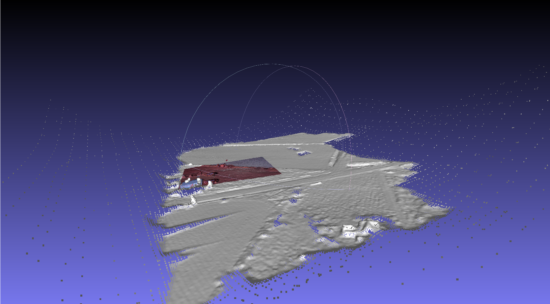
Pretty Picture Time...

Slide 13
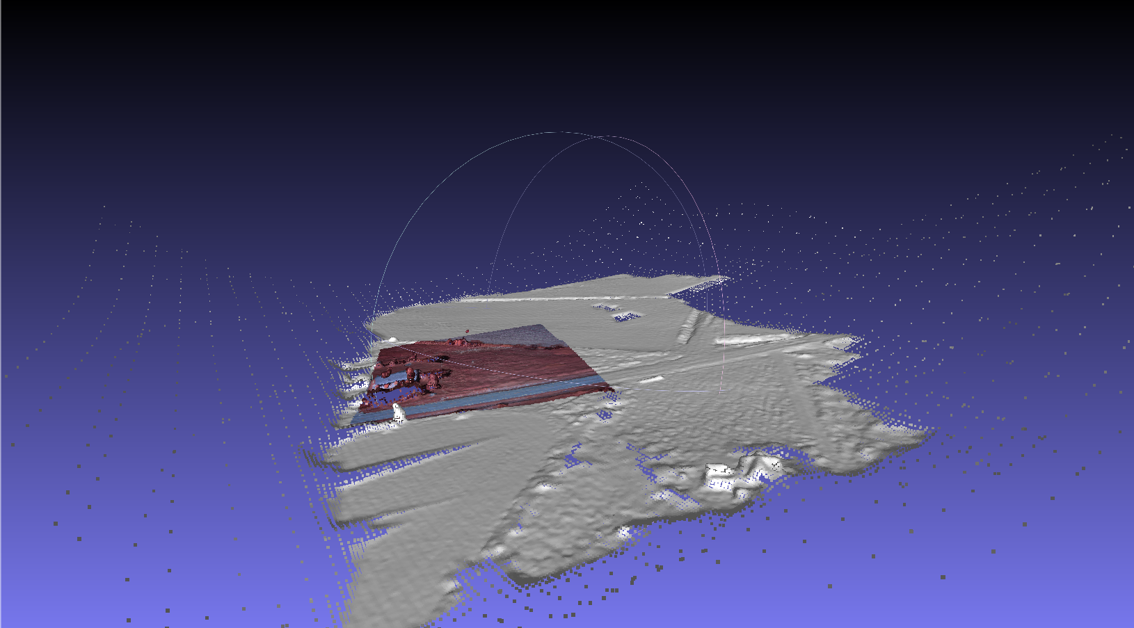
Pretty Picture Time...

Slide 14
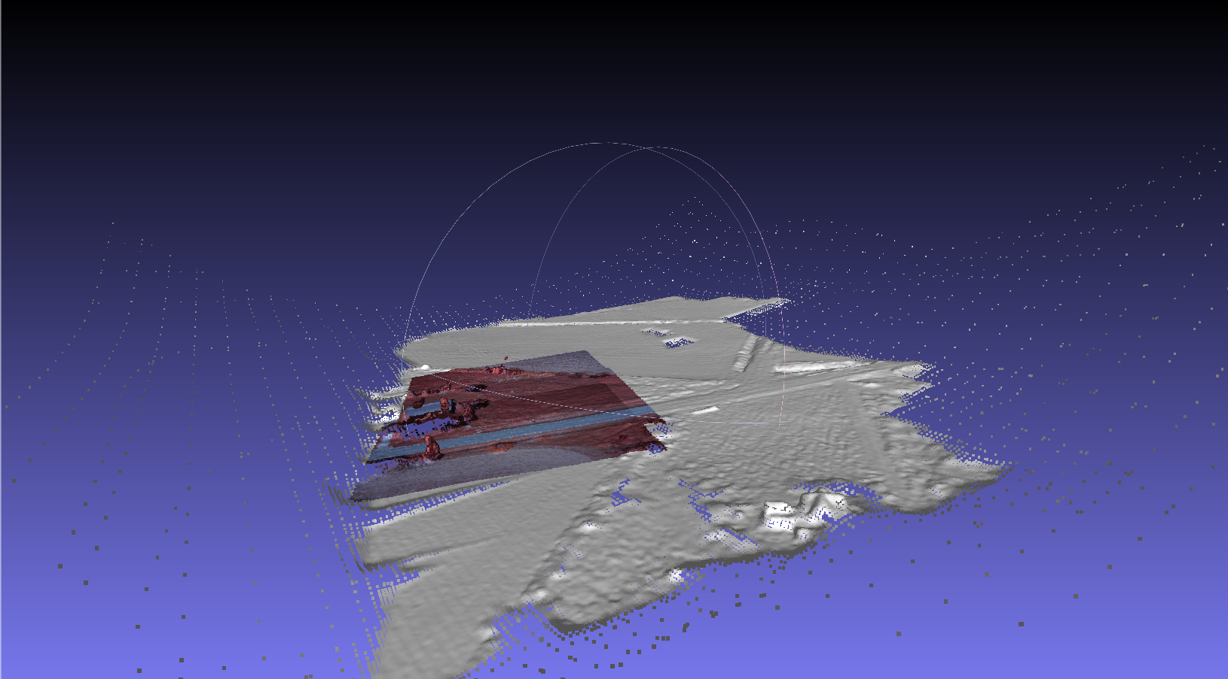
Pretty Picture Time...

Slide 15

Pretty Picture Time...

Slide 16
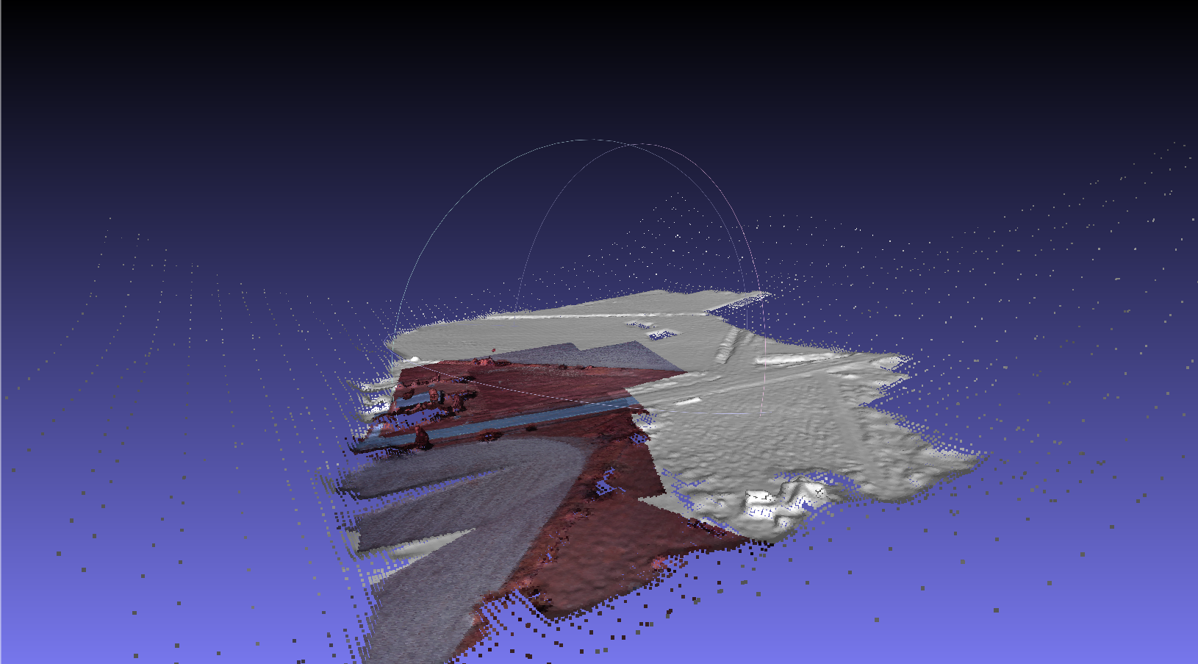
Pretty Picture Time...

Slide 17
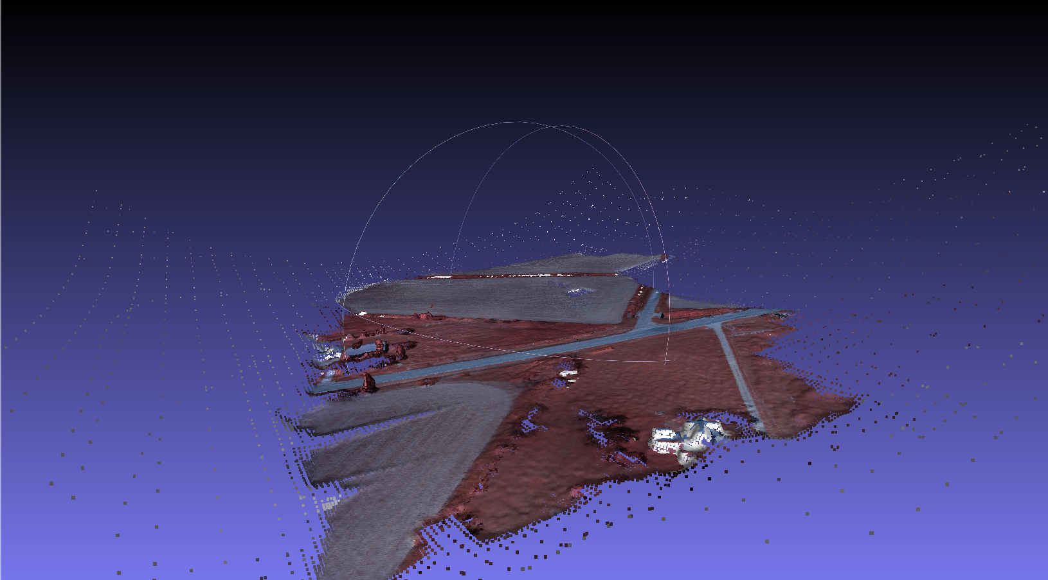
Pretty Picture Time...

